Slide 1
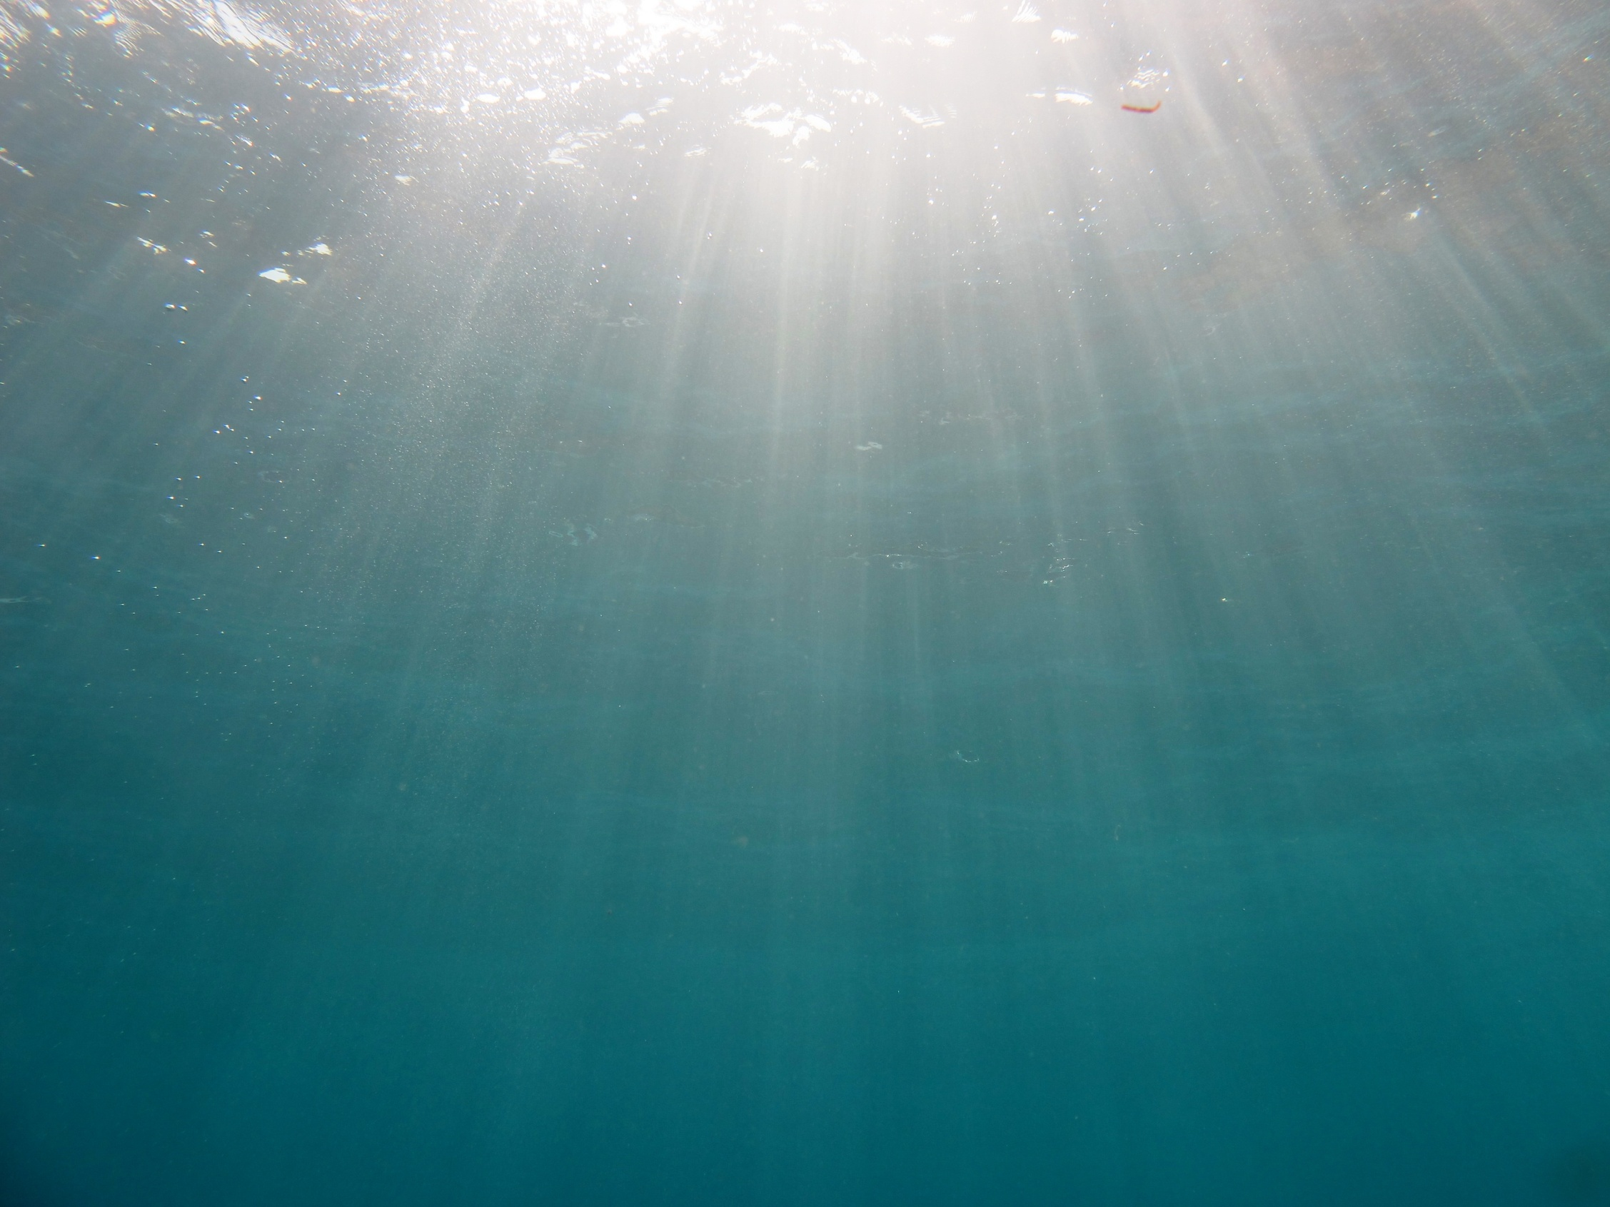


12th ICRS: Climate Change and Bleaching – Refuges for Corals in Time and Space
Solitons mitigate coral bleaching in the Andaman Sea
– the Porites perspective
Schmidt Gertraud M.¹,
Wall M.¹, Jantzen C.¹, Bürger P.¹, Khokiattiwong S.², Richter C.¹
¹ Alfred Wegener Institute for Polar and Marine Research, Bremerhaven, Germany
² Phuket Marine Biological Center, Phuket, Thailand

Slide 2
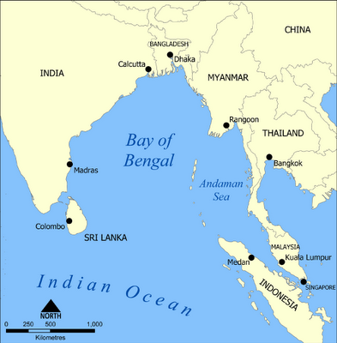
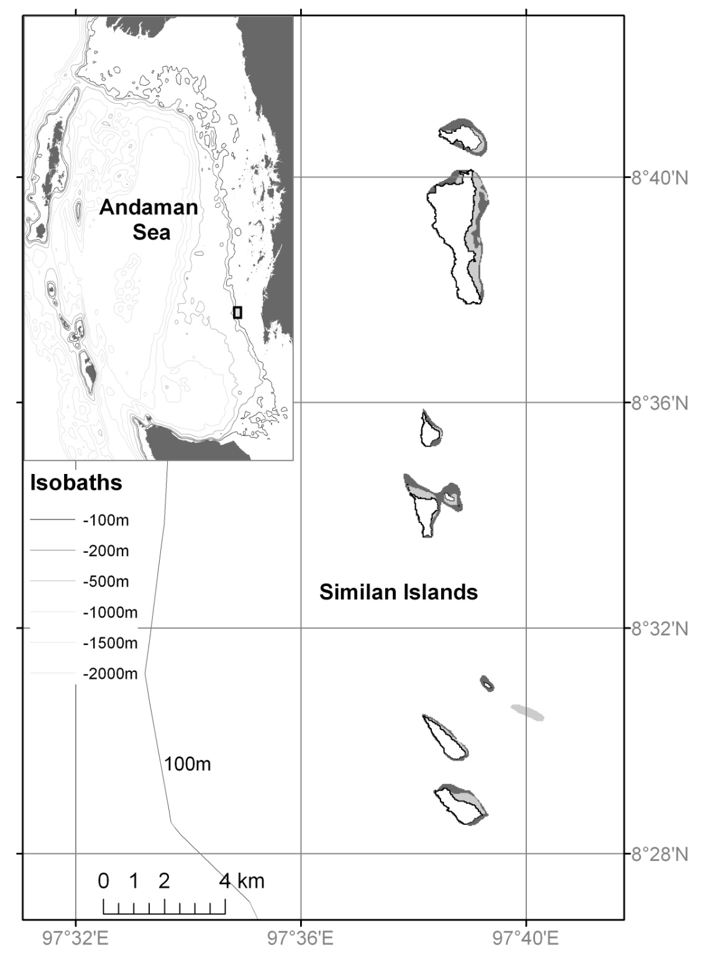
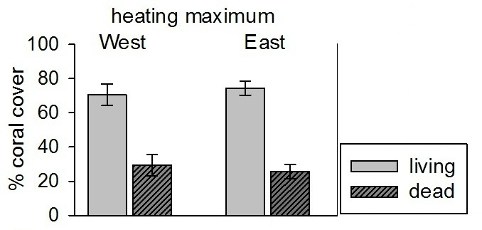
12th ICRS: Climate Change and Bleaching – Refuges for Corals in Time and Space
Study site:
Similan Islands
West East
working depth: 15 m
Notes:
Study was performed in the Andaman Sea, East of the Bay of Bengal
The actual study site was then the Similan Island chain
Located about 60km west off the Thai coast and close to the 100m shelf break
A total of 9 granitic islands in a perfect north-south alignment
With a total length about 24 km
ocean facing W sides
shelf-facing E sides
We see indicated by the grey shaded areas the coral reef distribution –
Light grey areas mark shallow reef areas down to 10 m depth
Dark grey areas mark reef areas down to 25 m depth
so the districution of a complex three-dimensional reef is restricted to the east
Yet when looking at the only 2-dimensional coral cover
We have a similar living coral cover in W and E in our working depth
So there is a quite dense cover of single coral colonies in W as well
The working sites along the island chain are marked with the symbols in the map – so we worked at 6 sites in total 3 in the W and 3 in the E representative for the island chain

Slide 3
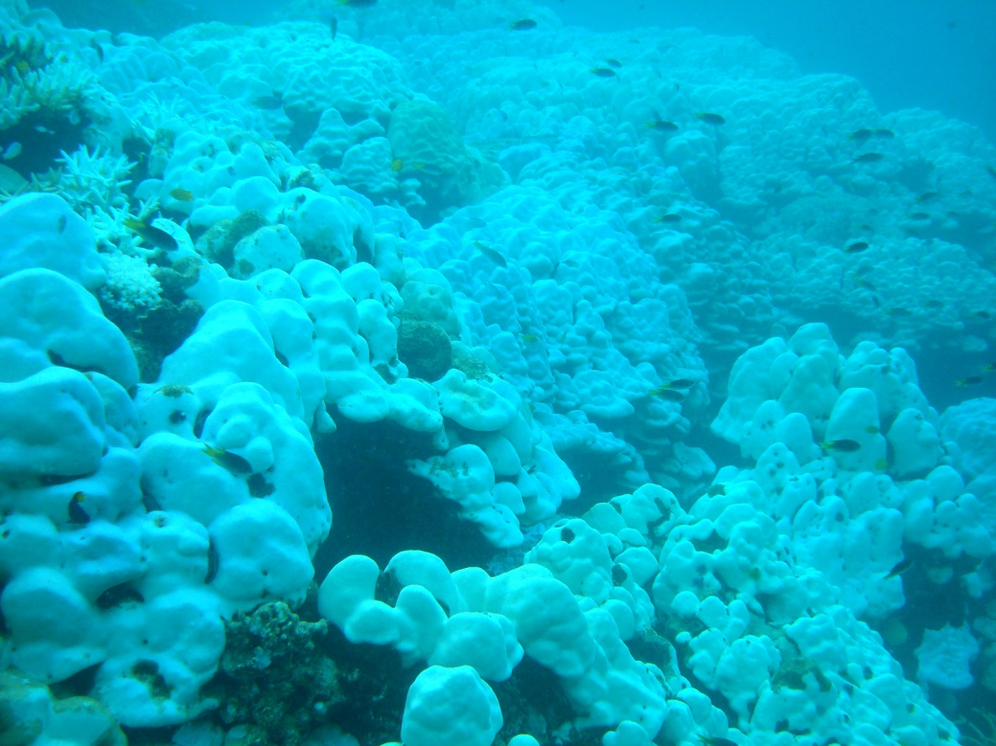
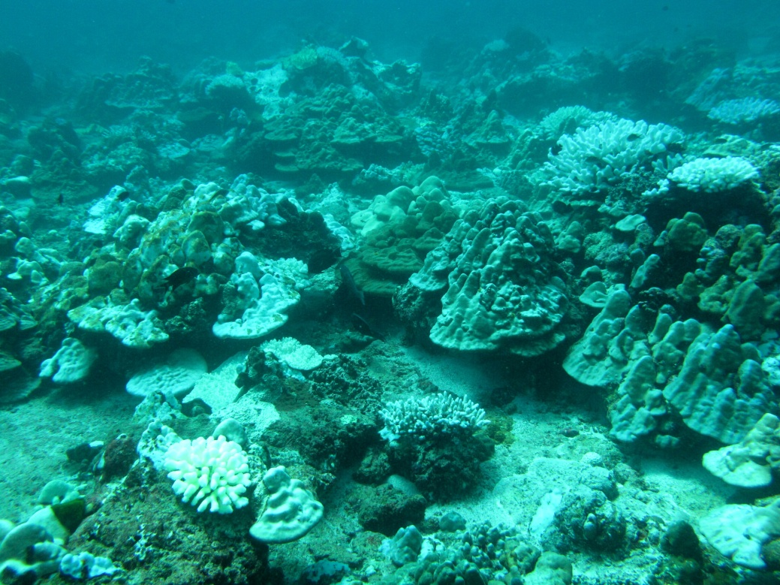
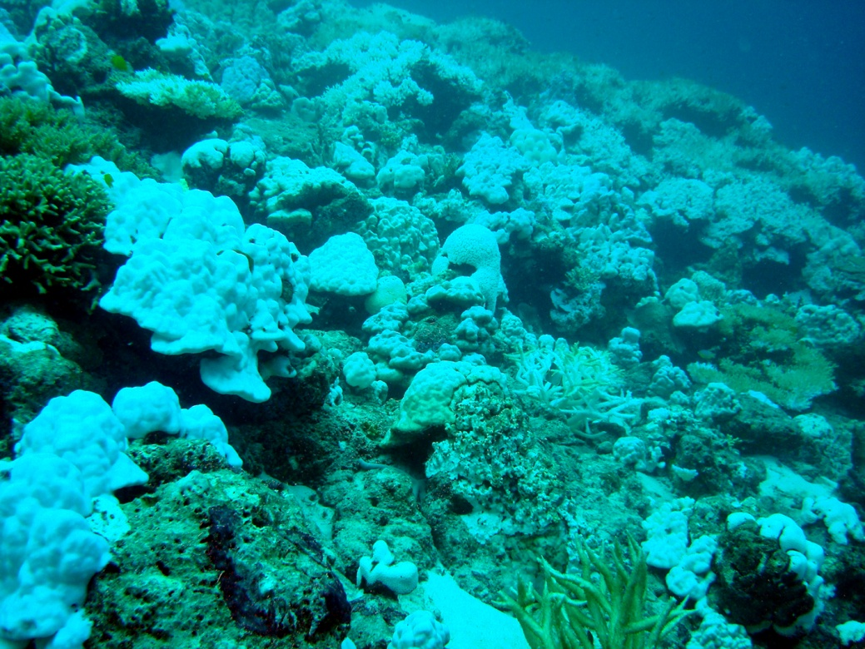
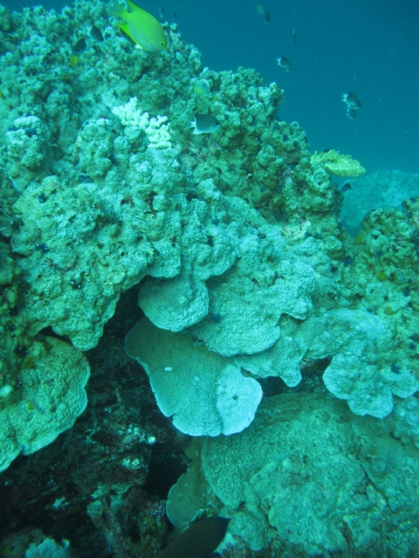
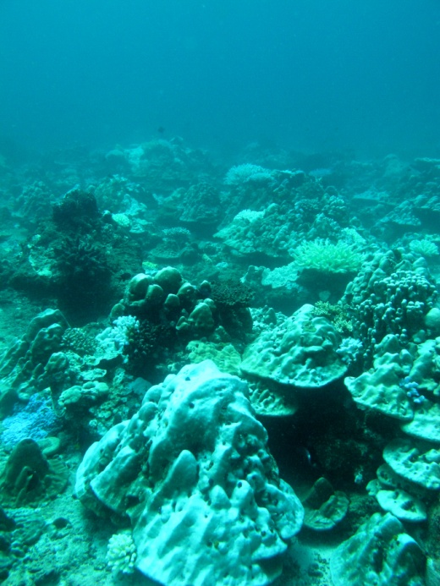
12th ICRS: Climate Change and Bleaching – Refuges for Corals in Time and Space
Shelf facing East
Andaman bleaching 2010
Ocean facing West
Notes:
In 2010 there was the most severe bleaching event in the Andaman Sea ever
Although there have been several bleaching events in the region ijn 1991, 1995, and 2003
Following an intense heating anomaly lasting over 80 days above the bleaching threshold of the area
Which resulted in an extensive bleaching of corals in whole reef areas
These pictures show you an impression of the bleaching at our study sites along the Similans in East
and in West at the heating maximum in May 2010
Nevertheless when looking more precisely at the tissue conditions we found that the bleaching seemed to be less intense and
entire along the Western sides in contrast to the East

Slide 4
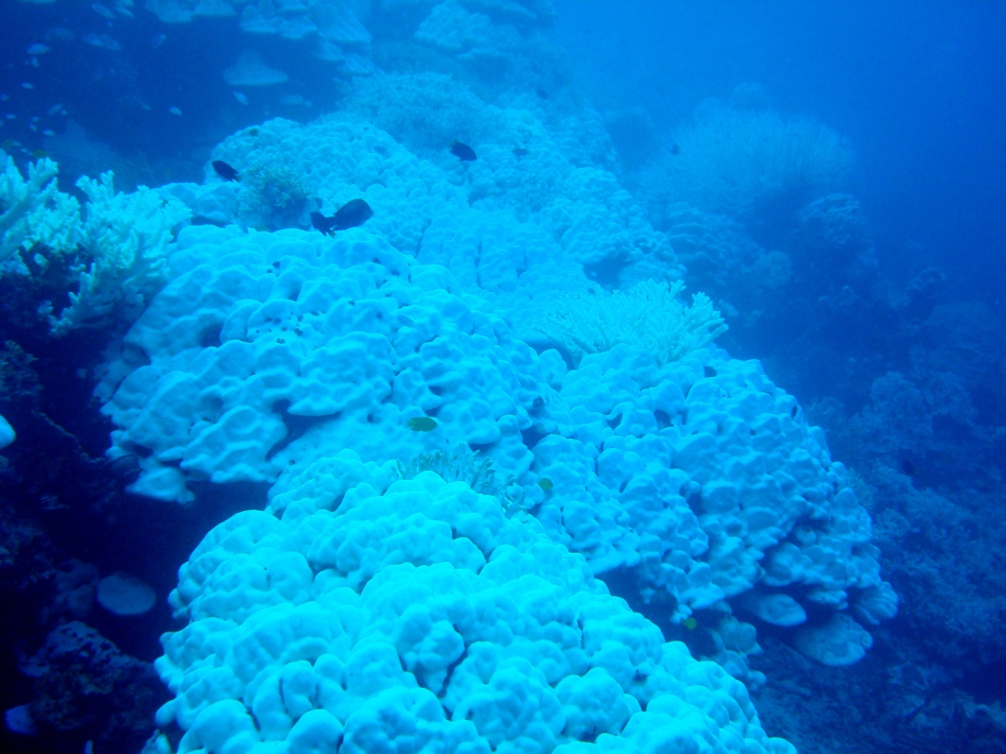
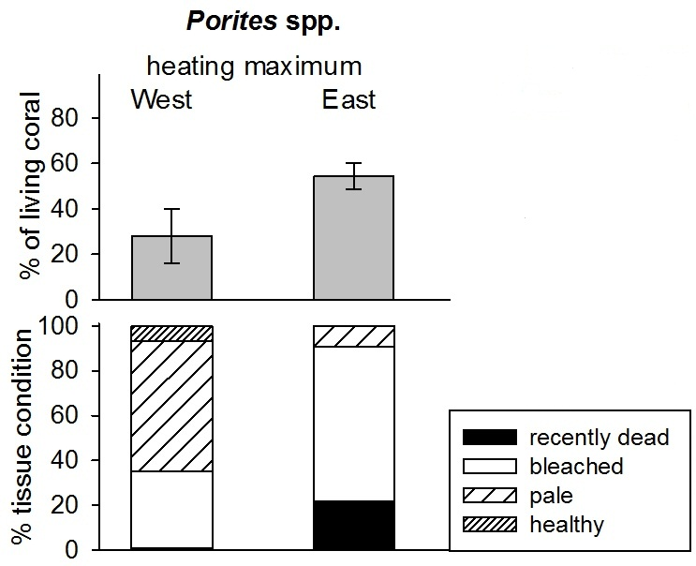
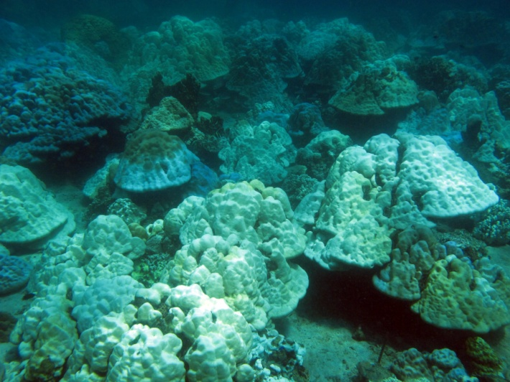
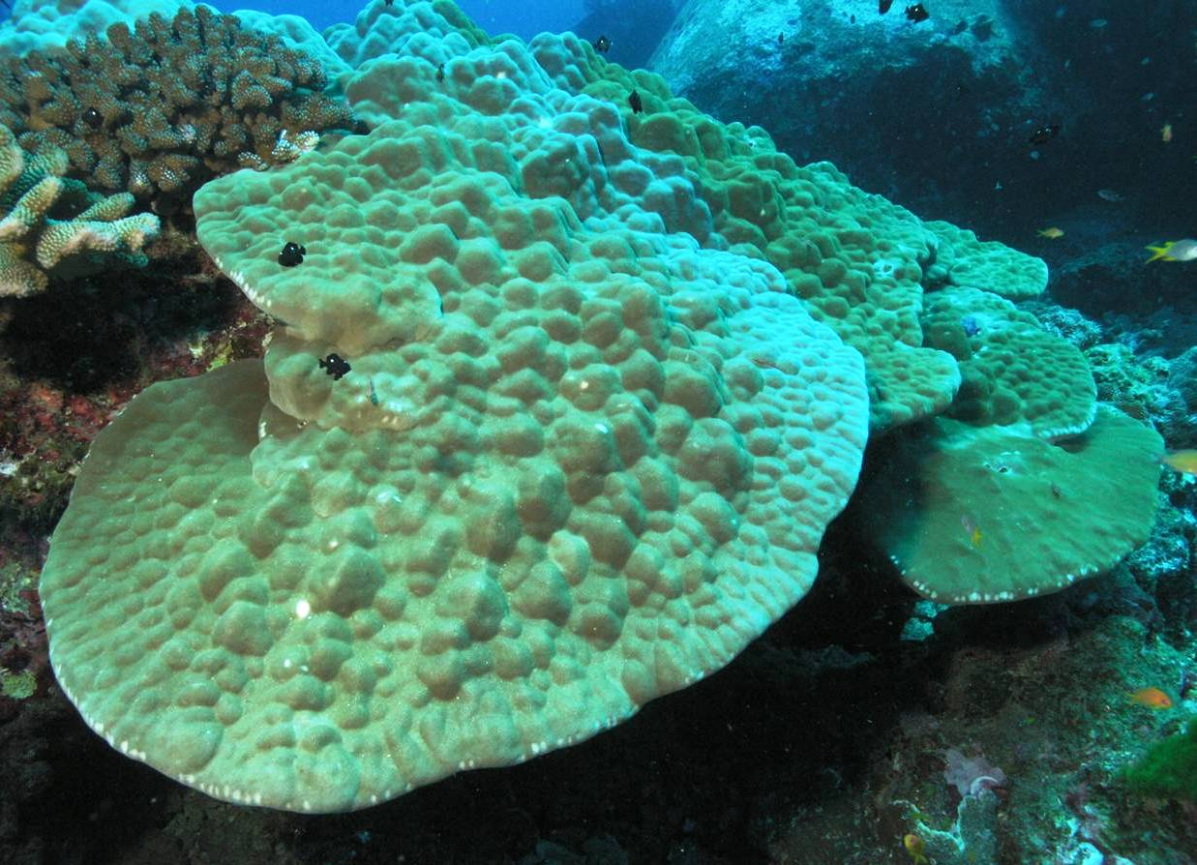
12th ICRS: Climate Change and Bleaching – Refuges for Corals in Time and Space
Study organsim: Porites lutea
Notes:
So when looking at our study organism
Porites lutea
Known to be a resilient and very robust species
But still we wanted to work on it because it is the dominant reef builder along the Similans and adjacent islands
And very common in the Andaman Sea
So we compared the status of Porites from picture analyses during the heating maximum in May 2010
The upper plot shows you the cover of Porites in percentage of the living coral cover at West and East
And the plot below shows you the tissue condition
We see that….
This lead us to the question why is that so….and we looked more in detail into the tissue conditions of Porites lutea before, during and after the thermal anomaly
Along the West and East Similans

Slide 5
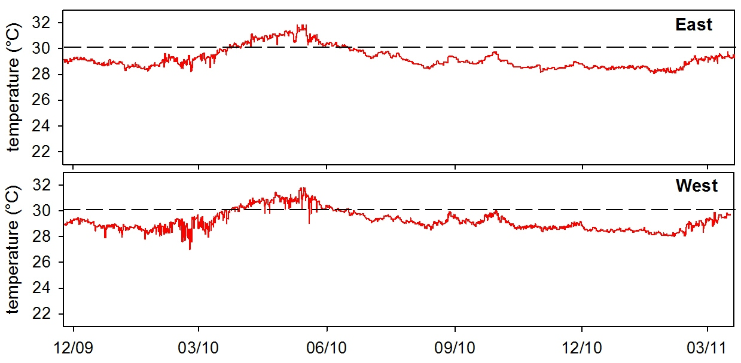
12th ICRS: Climate Change and Bleaching – Refuges for Corals in Time and Space
Thermal anomaly 2010
March08
May10 July10 Dec10 March11
30.1°C
30.1°C
temperature mode
Thermal anomaly > 80 days above threshold
peak values around 32 °C
Notes:
This is the mean temperature record given as the daily mode value (so the most frequent value in the record)
From November 2009 until the end of March 2011
Most severe heating event in Andaman Sea coast of Thailand ever
With peak values around 32°C extending down to 30 m depth
daily running mode exceeding bleaching threshold of 30.1 °C for 84 days
This threshold we defined by Brown et al. 1996 for this area as the temperature above which bleaching is very likely to occur…
We sampled coral tissue prior to the thermal anomaly in March 2008
Right after the heating maximum in May 2010
About 2 weeks after the heating anomaly had passed
About 5 months later in Dec 2010
And then finally almost a year after the heating anomaly had started in March 2011
samplings prior, during and after heating anomaly

Slide 6
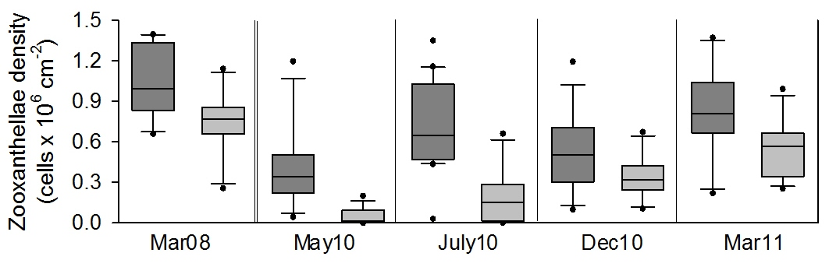
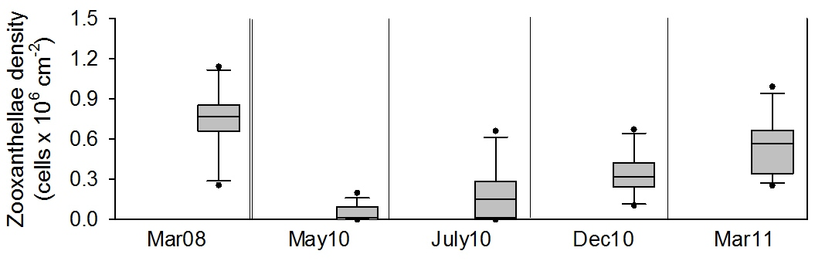
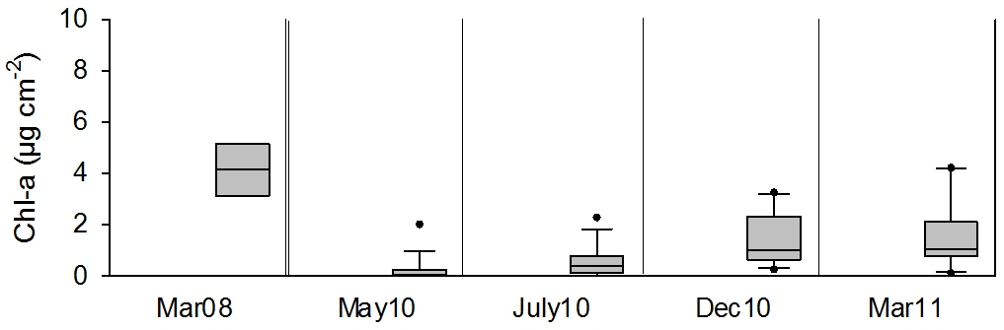
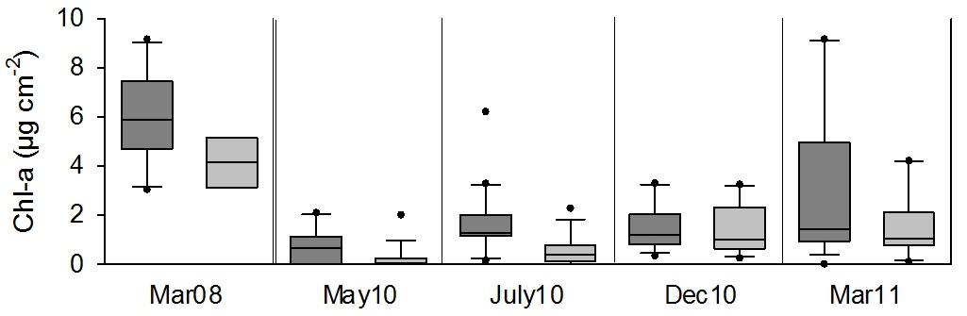
12th ICRS: Climate Change and Bleaching – Refuges for Corals in Time and Space
Zooxanthellae density and Chlorophyll a
East
West
N = 10-21
per sampling
Notes:
To the tissue conditions and parameters
This plot shows you the zooxanthellae density per cm-2 coral surface
And the chlorophyll a content per cm-2 coral surface
5 panels are shown – the first panel shows the values before the heating anomaly (data from March 2008) and the panels after that show the development during and after the heating event
At the East: we see a significant decrease in zoox density and chla between before the heating anomaly and right after the heating maximum in May
Values are reduced to very low or even 0 - nothing is left
Then we´ve seen a slown but steady recovery of the values until our last sampling in Mar11 (values had not yet reached the before status)
At West: higher zoox density and chla concentration before heating event
Here also a significant decrease during the heating event BUT significantly less intense than in E
And another feature in these data is the quite fast recovery already shortly after the heating had ended (July10) – until in March2011 the values had partly regained their original concentrations
A peculiarity here is the stagnation of the recovery which we measured in the tissue in Dec10
I´ll come back to this later in a bit

Slide 7
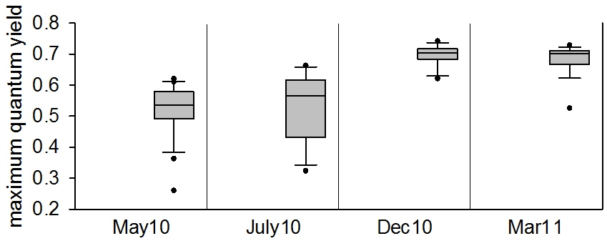
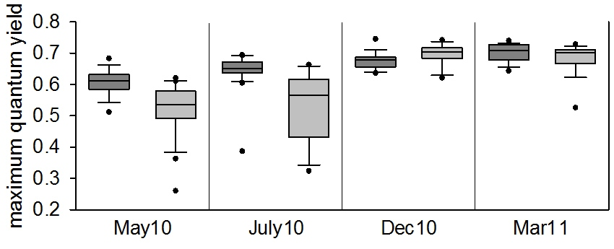
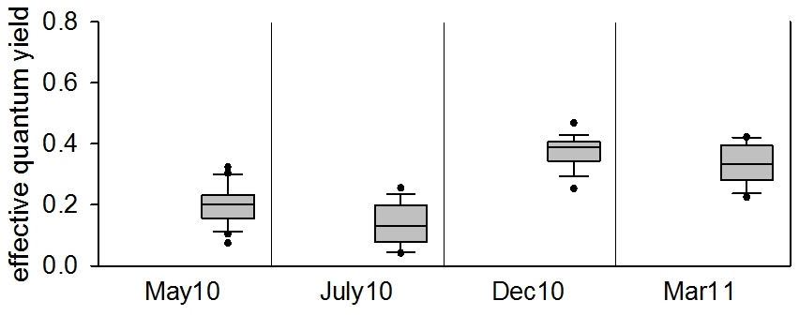
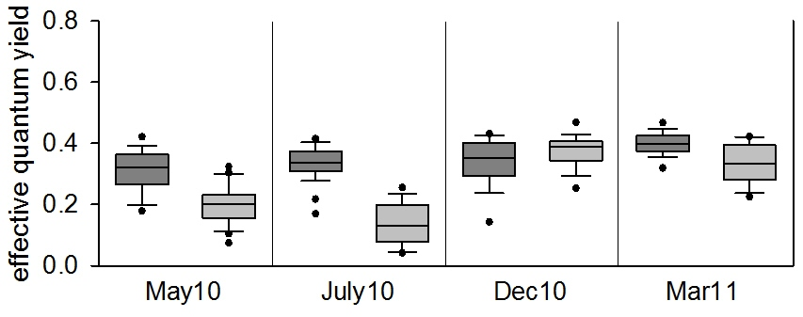
12th ICRS: Climate Change and Bleaching – Refuges for Corals in Time and Space
Photosynthetic performance
measurements
after 30min
dark adaptation
measurements
after 1min
actinic light stress
(600 µmol m⁻² s⁻¹)
East
West
N = 15-30
per sampling
Notes:
Photosystem II photochemical efficiency: which we measured with pulse amplitude modulated fluorometry – a diving PAM
First panel: maximum quantum yield after dark adaptation of the coral fragments for 30 min
Second panel effective quantum yield after exposure of the corals to saturating light for 1 min (600 µmol m⁻² s⁻¹)
East:
we see after the dark adaptation under stress free conditions we measured relatively high values even during the heating event which then recovered until Dec2010 (5 months after the heating)
Under light stress the sensitivity and weakening of the coral-symbiont status is more visible with low values even until after the heating and a recovery visible until 5 months after the heating
West:
Compared to E throughout higher values – barely differences in maximum quantum yield
And also after light stress the photochemical efficiency seems not to be as affected as in E
YET again – not as clear as for the zoox and chla values but still visible is here the stagnation of the values in Dec 2010 compared to July 2010 –
So we did measure higher values (not significant) but still visible in E in Dec 2010 before then in Mar11 again W values were higher

Slide 8
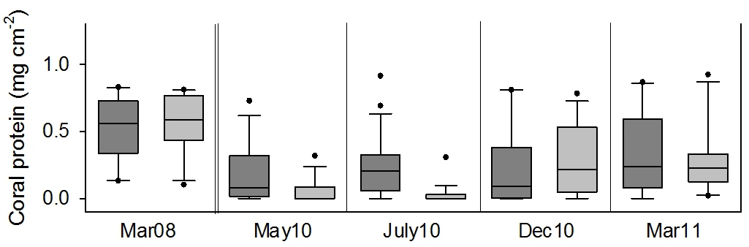
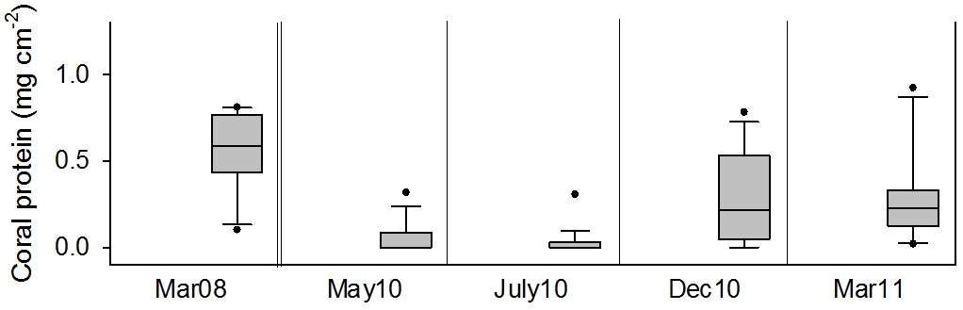
12th ICRS: Climate Change and Bleaching – Refuges for Corals in Time and Space
Coral total protein
East
West
N = 10-20 per sampling
Notes:
The final plot shows the total protein content of the coral tissue
As a proxy for the energetic status for the coral host resulting
on one hand from the nutritonal status of the corals and
from the photosynthetic energy supply
Again first the E corals:
The protein content shows the same performance as seen for the zoox and the chla content
Significant decrease during the heating with no recovery visible after the heating had ended (July2010)
But then until Dec2010 we see increased concentration – yet even after one year values are not back at the status which they had before the heating
West:
Similar concentrations at W as at E before the heating
Decrease during the May heating significant but clearly less intense than in E
Recovery until July visible and then a steady but slow regain in protein until our last measurement in Mar11
To come to the possibly explanation for the differences between West and East coral conditions…

Slide 9
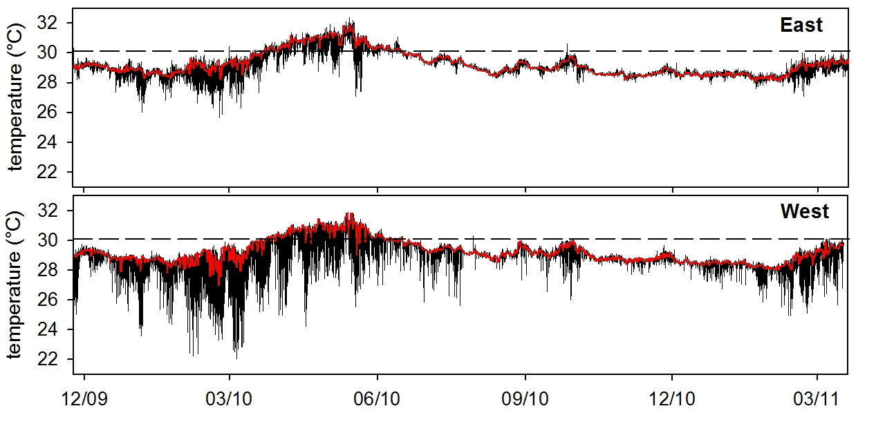
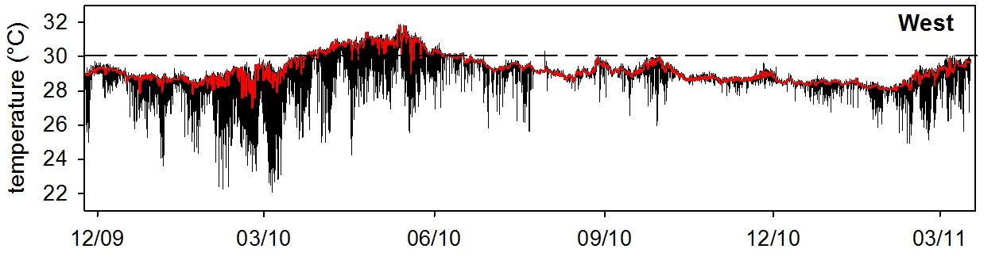
12th ICRS: Climate Change and Bleaching – Refuges for Corals in Time and Space
Thermal anomaly and raw temperature record 2010
May10 July10 Dec10 March11
30.1°C
∆T cooling < 3 °C
∆T heating > 2 °C
30.1°C
∆T cooling > 6 °C
∆T heating < 2 °C
temperature mode
temperature record (3min interval)
Notes:
Again back to the temperature record with the mode values
When we add the raw temperature record in W and then in E
We see strong temperature fluctuations present at W and only in very extenuated from in E
These temperature fluctuations were present throughout the year but with a peak activity from January through April
Characteristic for these temp fluctuations are that the temp drops within minutes and that the cold water stays in the reef area not longer than some 30min before the system „recovers“ back to warmer temperatures – these cold water flushes occur in several events per day so that the corals are exposed to a recurring cooling
This cooling below the mode temp is bigger than 6 °C in W but below 3°C in E
in contrast to that the heating above the threshold was bigger than 2°C in E but below 2°C in W
To explain the oceanographic phenomenon behind these cold water flushes…
.

Slide 10
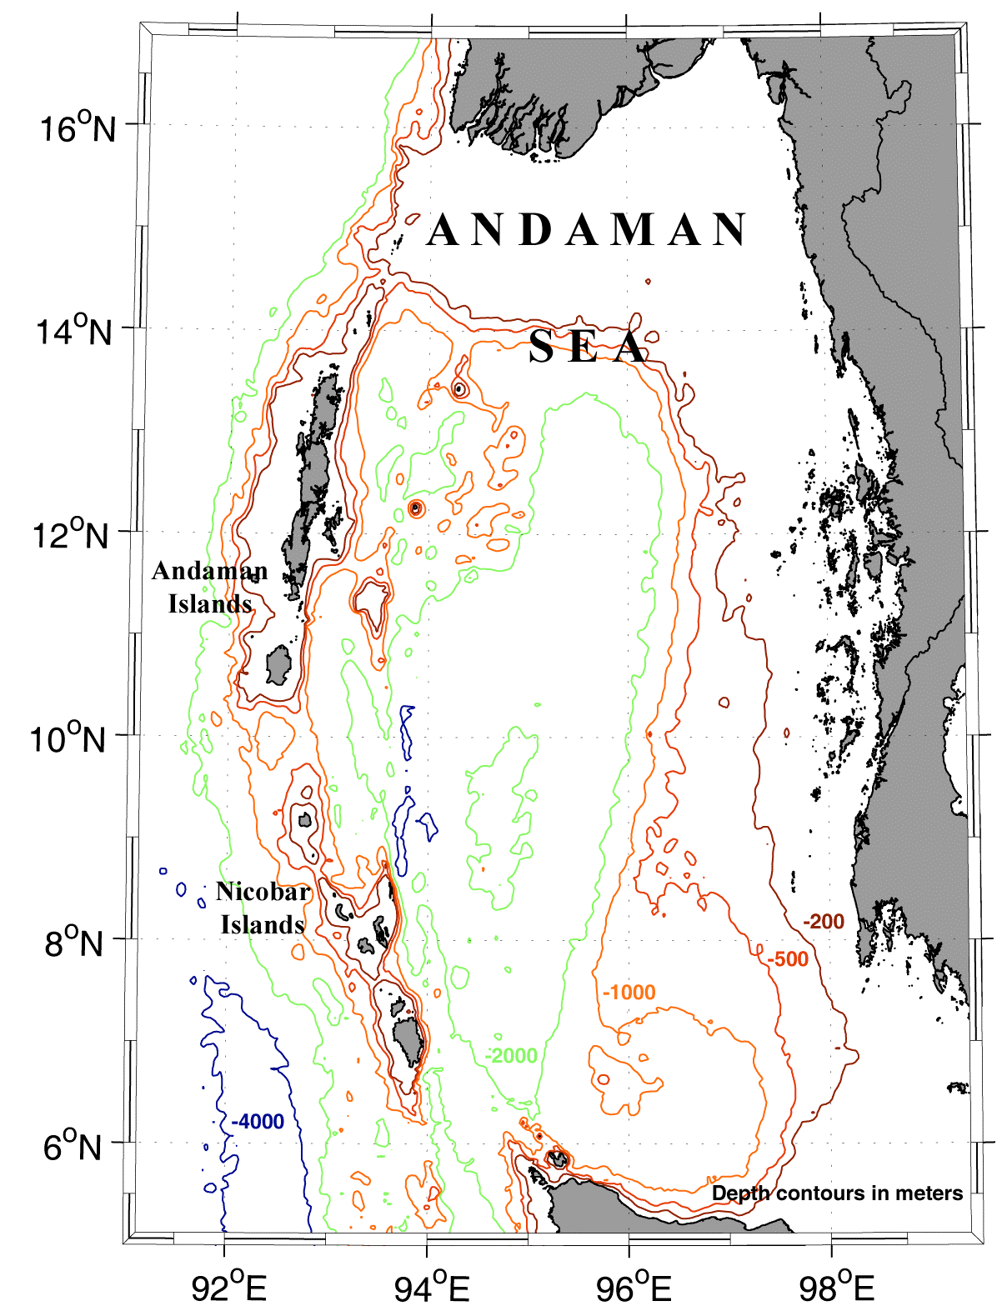
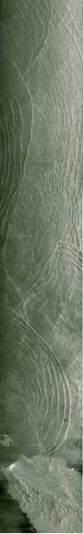
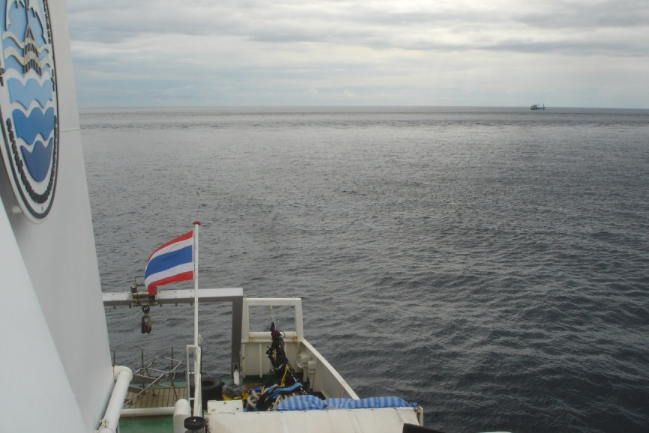
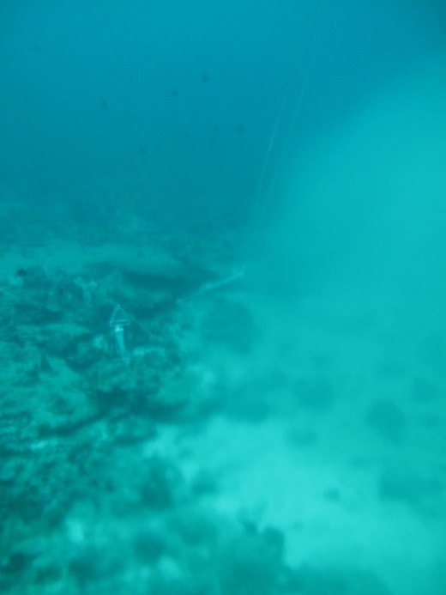
12th ICRS: Solitons mitigate coral bleaching in the Andaman Sea – the Porites perspective
Oceanographic and climatic conditions
Large amplitude
internal waves
(LAIW) or solitons
peak activity
January through April
Similan West 15m
Modified after Jackson 2004
Notes:
The Andaman Sea is known for the ocurrence of
Large amplitude internal waves
LAIW or solitons
these are internal waves within the water column travelling along a density separation layer – the pycnocline
They can occur whereever there is a stratified water column, a rich underwater topography and tidal currents
In the Andaman Sea they are generated at Andaman-Nicobar island arc & northwest of Sumatra
in groups or packages
from W/SW to E
Amplitudes in deep water of more than 60m, speed about 2m s-1
When they reach the shelf break, build secondary waves which continue travelling upslope and reach shallow water areas….where they can then bring cold sub-pycnocline waters into shallow
solitons: year round ocurrence,
peak activity January through April
On the water surface they can be seen as ripple bands as for example in this satellite image)
But also from the very surface as we´ve seen them from the research vessel…
Under water ….

Slide 11
12th ICRS: Solitons mitigate coral bleaching in the Andaman Sea – the Porites perspective
Oceanographic and climatic conditions
Large amplitude
internal waves
(LAIW) or solitons
peak activity
Januar y through April
SW monsoon regime
from May to
October
Modified after Jackson 2004
Notes:
the second characteristic of the Andaman Sea is then the SW Monsoon
Dominating the region from May to October with heavy rain and strong ocean swell – sometimes even storm like surface waves…
The monsoon as well as the solitons only reach the westren ocean facing sides of the offshore islands…the eastern sides are largely sheltered from both phenomena – at least concerning the deep water influence and the surface wave action

Slide 12
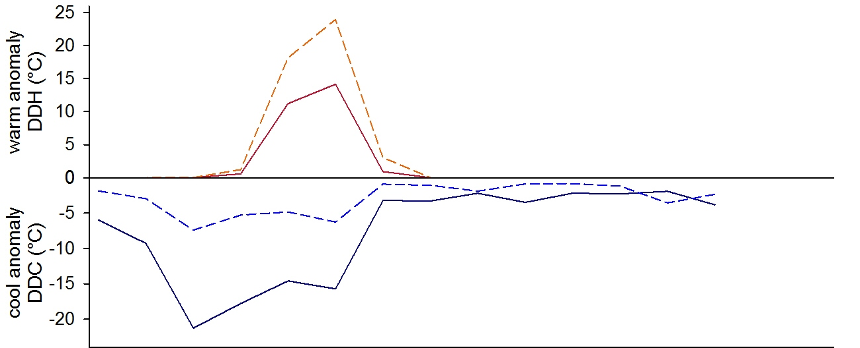
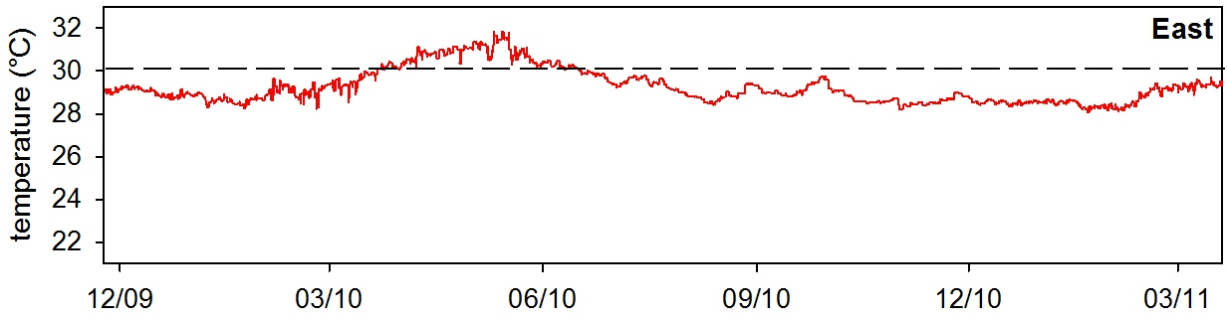
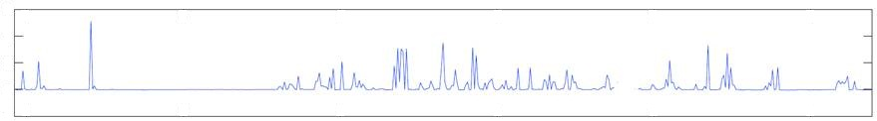
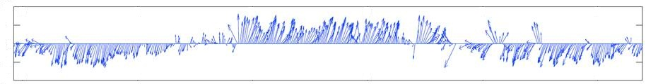
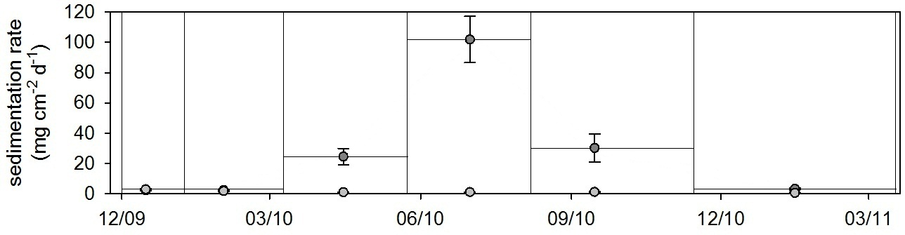
12th ICRS: Climate Change and Bleaching – Refuges for Corals in Time and Space
Summary and conclusions
heating > 30.1 °C
East
Solitons
cooling effect
mitigate coral bleaching
facilitate recovery
West
West versus East
> 50% less heating
> 70% higher cooling
cooling < mode temperature
Monsoon
heavy rain and ocean
swell
hydrodynamic energy
sedimentation
retarding recovery
6
4
2
0
rainfall (cm)
10
5
0
-5
wind speed
(m s⁻¹)
0
East
West
sedimentation effect only in West
Notes:
So to sum this all up
This plot shows the heating in DDH (per month) for West (straight line) and E (dashed line)
And the cooling in DDC (per month) below the running mode
When comparing West and East, we found….
So we may say that Solitons do have a….
But we do also have a second phenomenon in this region which acts from the same direction as the solitons and might be the reason for the stagnant recovery of the coral tissue parameters after July 2010 before the tissue values then where higher again in March 2011
This is the SW monsoon – with ist peak activity starting in June until the end of October…
Nevertheless the western corals showed a less intense bleaching and a faster recovery than the sheltered eastern once…which we think is due to the cooling effect of the solitons…

Slide 13
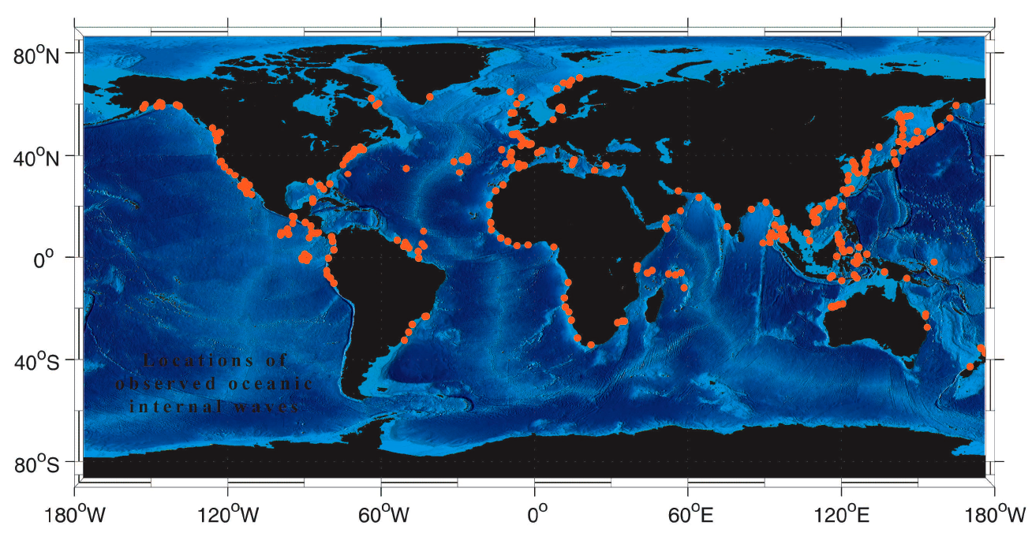
12th ICRS: Climate Change and Bleaching – Refuges for Corals in Time and Space
Relevance
Locations of observed oceanic internal waves
© Jackson 2004
Notes:
Concerning the relevance of this study….

Slide 14
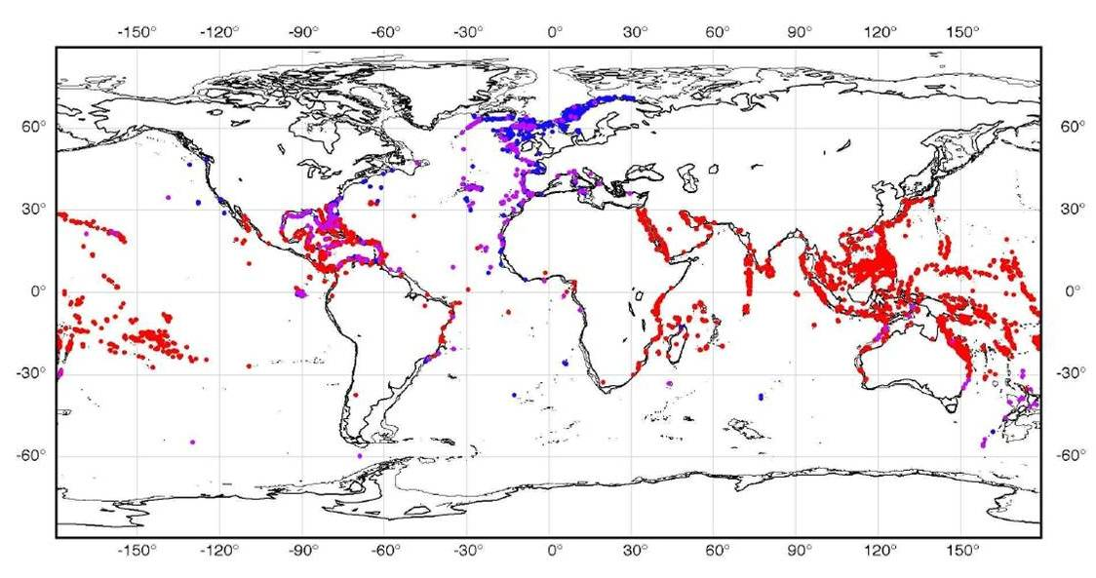
12th ICRS: Climate Change and Bleaching – Refuges for Corals in Time and Space
Relevance
● shallow tropical coral reefs
Center of coral reef
biodiversity
Notes:
….so I would like to conclude with the outlook that these areas where oceanographic internal waves occur might be areas where heating events can be attenuated and coral bleaching might be mitigated

Slide 15
12th ICRS: Climate Change and Bleaching – Refuges for Corals in Time and Space
Thank you
for your attention!
gertraud.schmidt@awi.de
© N. Phongsuwan

